Slide 1

6th Grade Accelerated
Unit 6, Lesson 12 Multiplying and Dividing Integers With Procedural Fluency Volume 1, pg. 287

Slide 2


Benchmark
MA.6.NSO.4.2
Apply and extend previous understandings of operations with whole numbers to multiply and divide integers with procedural fluency.
volume 1, pg. 287

Slide 3
Integrated Mathematical Thinking and Reasoning Standards
MA.K12.MTR.3.1 Complete tasks with mathematical fluency.
MA.K12.MTR.5.1 Use patterns and structure to help understand and connect mathematical concepts.
volume 1, pg. 287

Slide 4

Learning Target
I can multiply and divide integers with procedural fluency.
volume 1, pg. 287

Slide 5

Warm-Up
volume 1, pg. 288

Slide 6
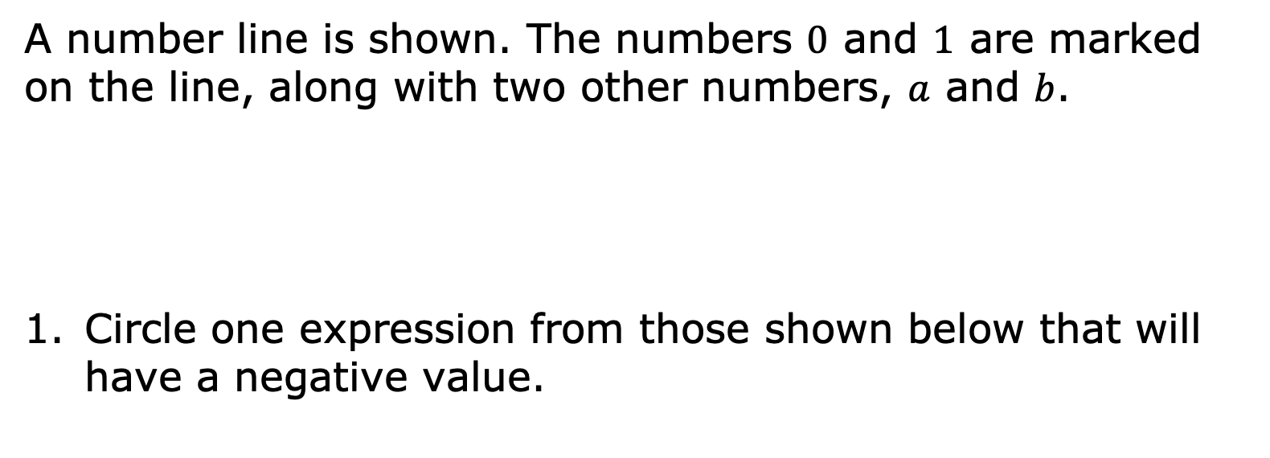
6.12.1 Warm-Up: Thinking Algebraically
A number line is shown. The numbers $0$ and $1$ are marked on the line, along with two other numbers, $a$ and $b$.
Circle one expression from those shown below that will have a negative value.
$$a−1$$ | $$a−2$$ | $$a+b$$ | $$a−b$$ | $$ab+1$$
volume 1, pg. 288

Slide 7
Explain how you know the expression selected will have a negative value based on the number line.
Find a classmate who chose a different expression that will have a negative value.
volume 1, pg. 288

Slide 8
Record their expression and explanation for why they chose it in the table. Then, have them initial that you recorded it correctly. You are the only person who should write in the first two columns of the table.
Classmate’s Selected Expression | Classmate’s Explanation for Why the Value is Negative | Initials
volume 1, pg. 288

Slide 9

Collaboration
volume 1, pg. 288

Slide 10

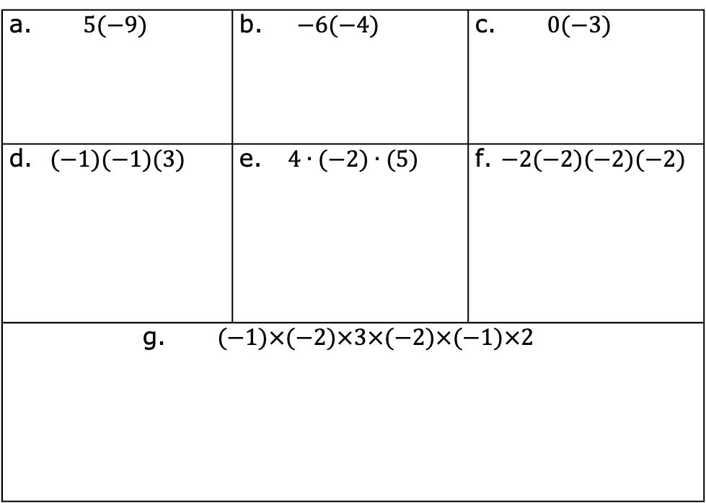
6.12.2 Collaboration: Multiplying Multiple Integers
Work with your partner to find the product of each expression.
a. $5(−9)$ | b. $−6(−4)$ | c. $0(−3)$
d. $(−1)(−1)(3)$ | e. $4∙(−2)∙(5)$ | f. $−2(−2)(−2)(−2)$
g. $(−1)×(−2)×3×(−2)×(−1)×2$
volume 1, pg. 288

Slide 11
In expressions d-g, more than two factors are being multiplied.
Discuss with your partner how the rules you developed previously for multiplying two integers could be extended for multiplying more than two integers.
Write at least one rule that would apply in this situation.
volume 1, pg. 288

Slide 12

Activity
volume 1, pg. 289

Slide 13





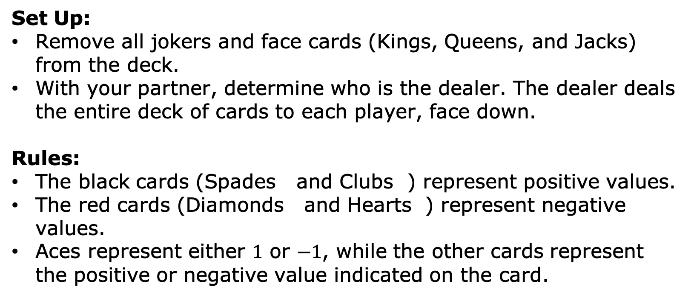
6.12.3 Activity: Integer War – Multiplication Edition
Set Up:
Remove all jokers and face cards (Kings, Queens, and Jacks) from the deck.
With your partner, determine who is the dealer. The dealer deals the entire deck of cards to each player, face down.
Rules:
The black cards (Spades and Clubs ) represent positive values.
The red cards (Diamonds and Hearts ) represent negative values.
Aces represent either $1$ or $−1$, while the other cards represent the positive or negative value indicated on the card.
volume 1, pg. 289

Slide 14
How to Play:
To begin, each player will flip over one card from their deck and place it in the center.
The first player who figures out the product of the two integers keeps both cards and adds them to the bottom of their stack.
NOTE: If a player says an incorrect product, the other player responds for a chance to win the hand before the first player can change their answer.
Repeat this process until time is called or until one player has all of the cards in the deck.
volume 1, pg. 289

Slide 15

Guided Practice
volume 1, pg. 289

Slide 16


6.12.4 Guided Practice: Finding Products or Quotients
Find each product or quotient.
$10 ×\left(−65\right)$ b. $−19×99$
$−812÷(−7)$ d. $\frac{208}{−16}$
$−125÷(−5)$ f. $(−21)(−16)$
volume 1, pg. 289

Slide 17

Your Turn
volume 1, pg. 290

Slide 18

6.12.5 Your Turn!
Find each product or quotient.
$−17 × 29$ b. $41∙(−19)$
$−184÷23$ d. $\frac{−175}{−5}$
volume 1, pg. 290

Slide 19
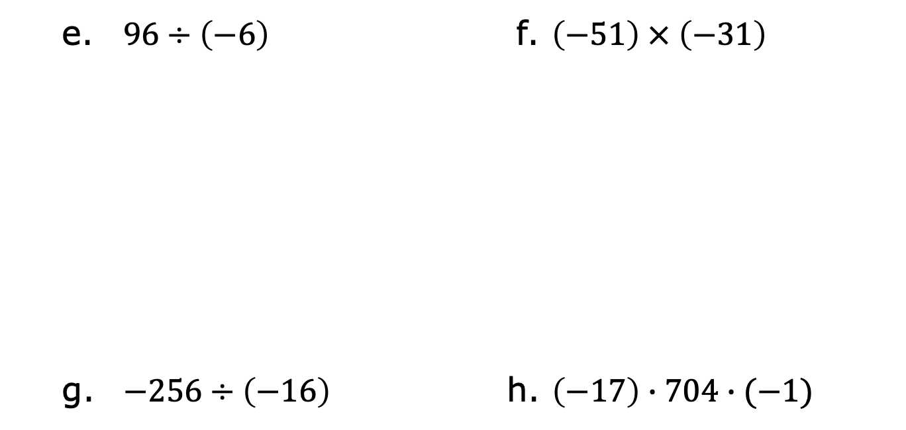
$96÷\left(−6\right)$ f. $\left(−51\right) × \left(−31\right)$
$−256÷\left(−16\right)$ h. $\left(−17\right)∙704∙(−1)$
volume 1, pg. 290

Slide 20

Wrap-Up
volume 1, pg. 290

Slide 21
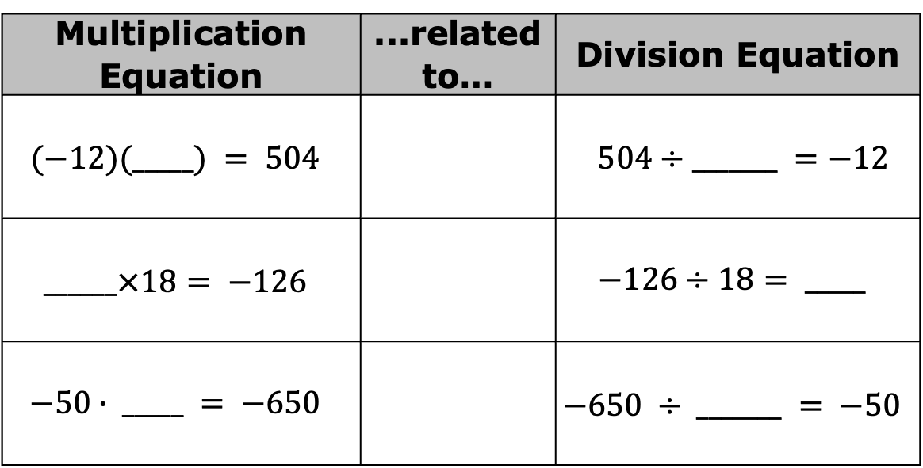
6.12.6 Wrap-Up: Ticket Out the Door
Complete the table by writing a value in each blank that completes each related equation.
Multiplication Equation | ...related to… | Division Equation
$$(−12)(_____) = 504$$ |  | $504÷_______ =−12$
$$______×18= −126$$ |  | $$−126÷18= _____$$
$$−50∙ _____ = −650$$ |  | $$−650 ÷ _______ = −50$$
volume 1, pg. 290

